Slide 1
Spring Rest Crud App
Part 1

Slide 2
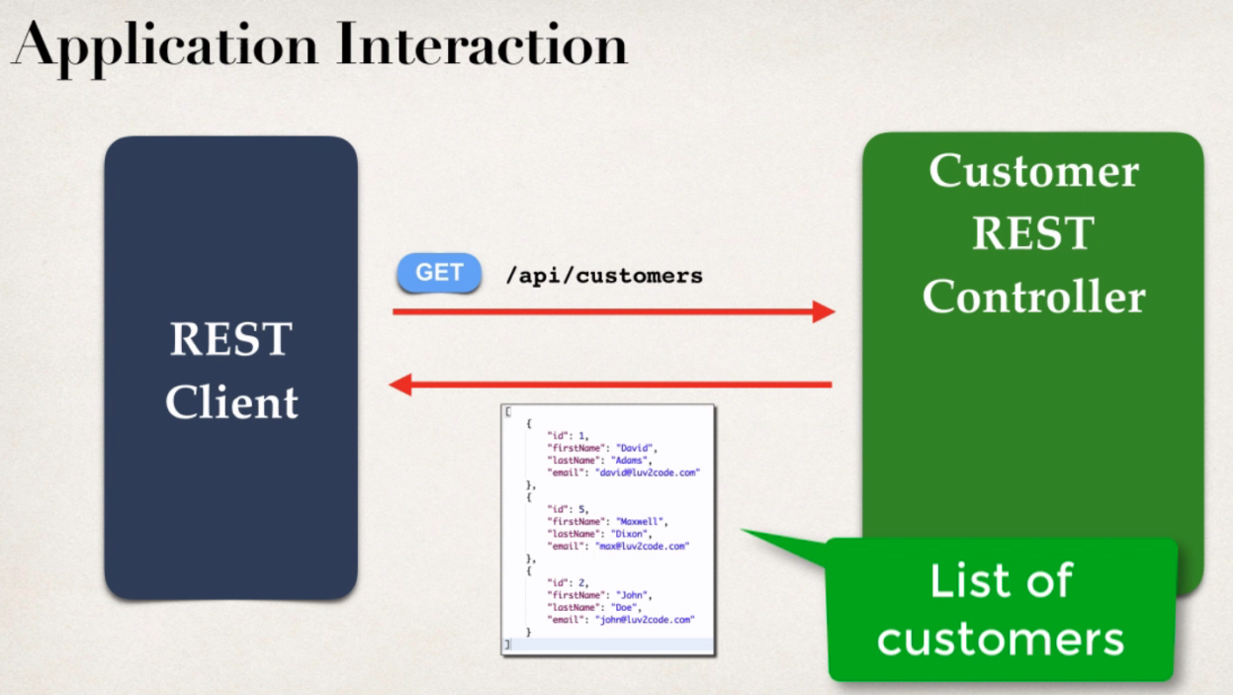
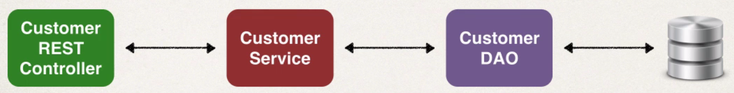
The Rest Client makes a get request with URI /api/customers then the RestController takes the information process it.
Then give list of customers in JSON format. We are reusing the code from our previous CRM project and replaced the controller class with RestController class, as we are making a rest api.
In the background Jackson will take the POJO, then convert them into JSON and send them over to the rest client.

Slide 3
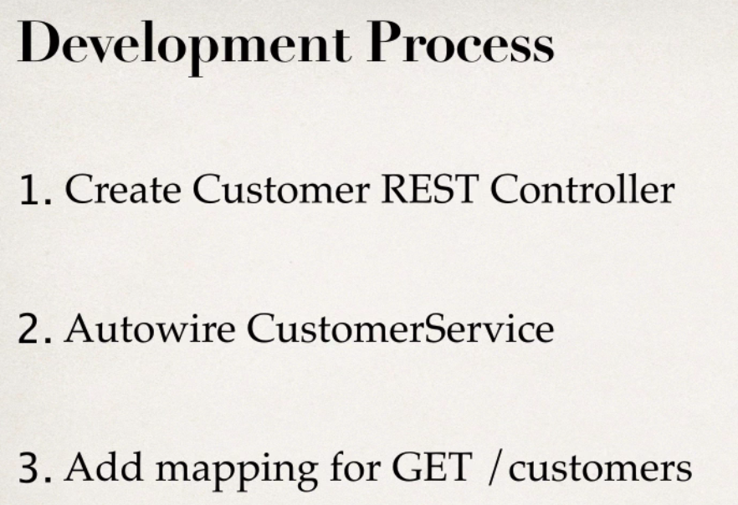
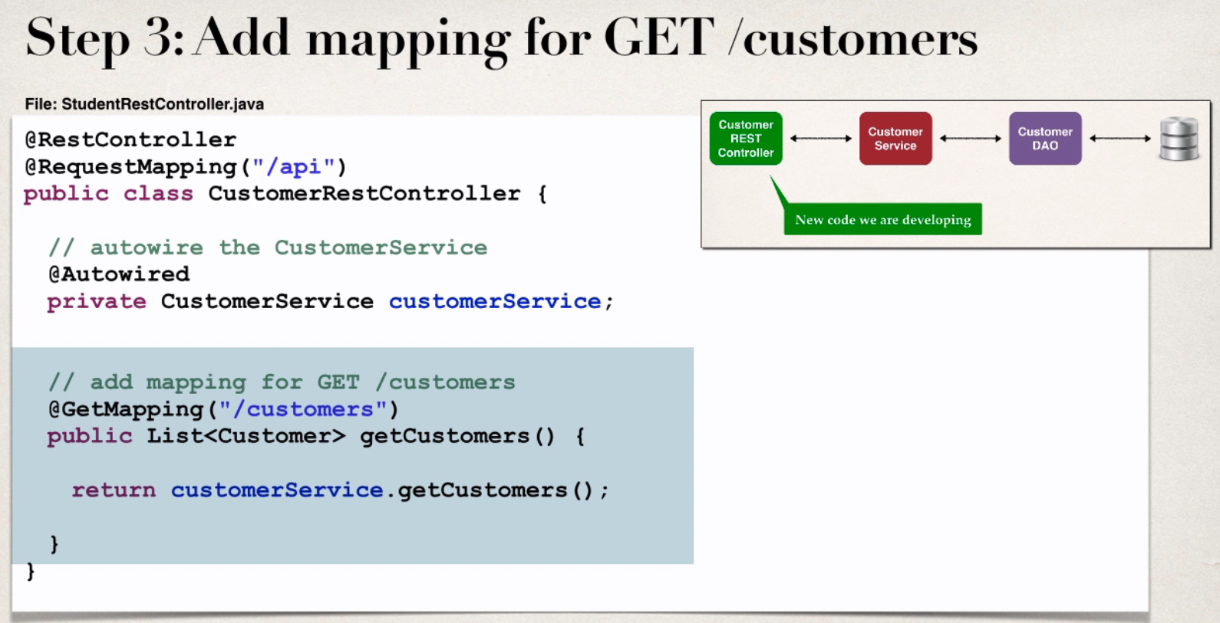
Import the maven project from spring rest
course folder. Create a new package for
RestController. Now create the controller
Class in that package as shown below.
All three steps shown in a single slide.

Slide 4
Once all the above three steps were done, open “persistence-mysql.properties” file. Change the package name under hibernate properties , because we have changed all the packages names.
Then run the project on server, make sure we were able to see the home page (http://localhost:8080/spring-crm-rest/)
Then open index.jsp in webapp folder, add a reference url for “/api/customers”, again rerun the project on server.
Make sure the newly added link “Get All Customers” working properly or not, in eclipse it is opening a pop up, asking to open or save a file.
That’s ok everything is working fine. Open a browser or Post man client give the url. It will works fine.(need to change some settings in windows , that’s ok it still works, leave it for now).

Slide 5
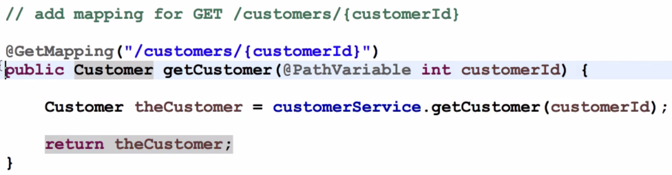
Getting customer Based on Id
Add mapping for “/customer/{customerId}” in the RestController class,
Run the application on server, open the post man give the uri for single customer like, http://localhost:8080/spring-crm-rest/api/customers/4
Then we can see customer details whose id is 4.
Incase if we pass the wrong id(id not exist in database), we are not getting error message in post man, we are getting a blank message because if Jackson displays null, if there is no matching id found in the database.
Also if we pass text instead of number as id, we are getting a ugly error message, it need to be fixed.

Slide 6
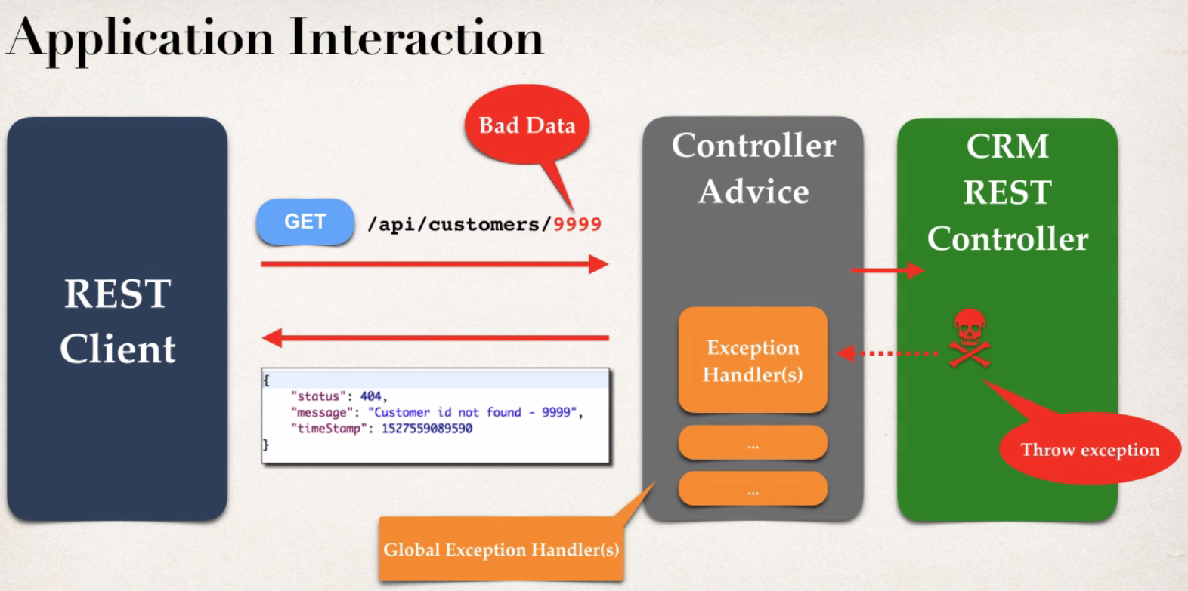
Spring CRM Rest Exception Handling
When ever we pass the invalid id, we have to throw an exception.
We create a Controller Advice class for handling exception, if we pass invalid id CRM RestController throws exception.
The Controller Advice class handle the exception and it sends JSON response (not found) to the client.

Slide 7
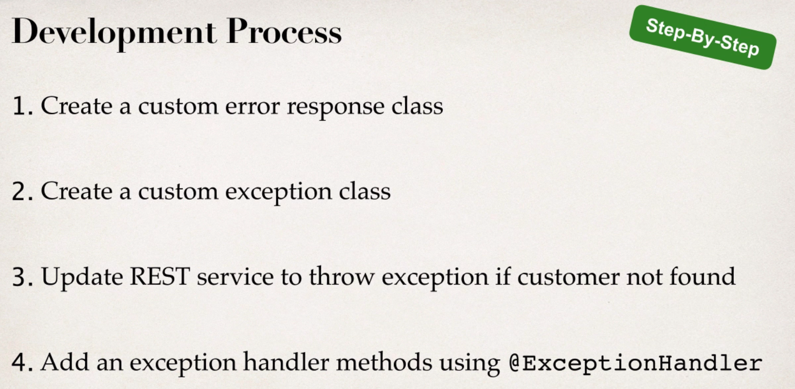
1. Create a class CustomerErroResponse class in controller related package. Add private fields called, status, message, time stamp
Add to no arg constructor, parameterized constructor, getters and setters.
2. Then create a custom exception class called, CustomerNotFoundException, add super class RuntimeException, also add constructors from super class, while creating this class(eclipse trick).
3. Create a class called CustomerRestExceptionHandler, in which we Add an exception handler for CustomerNotFoundException and for any other exceptions.

Slide 8
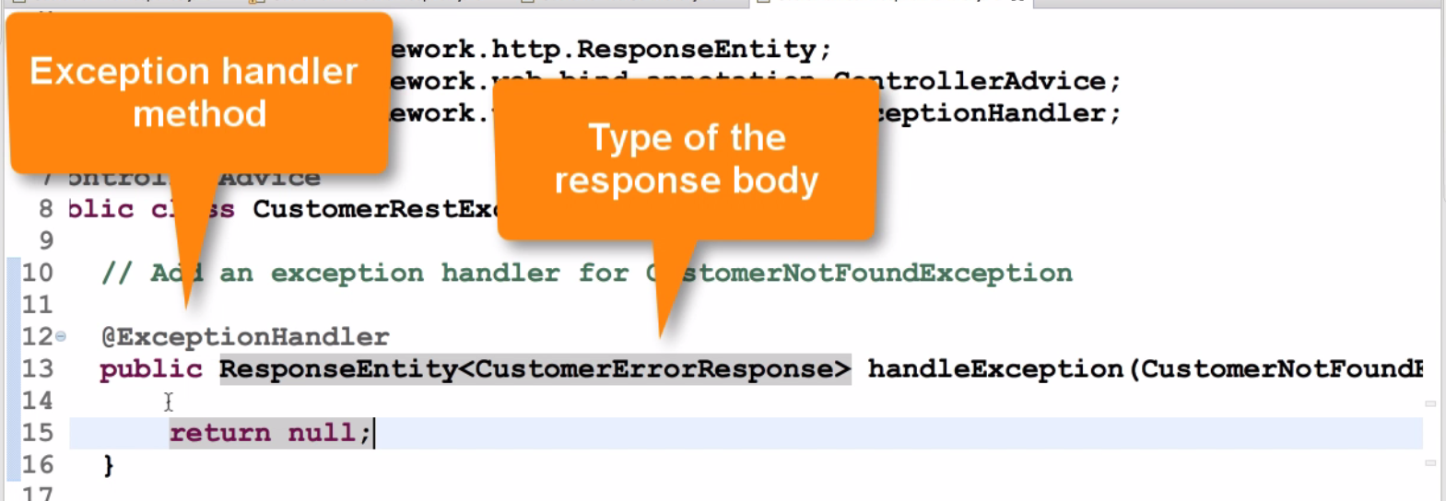
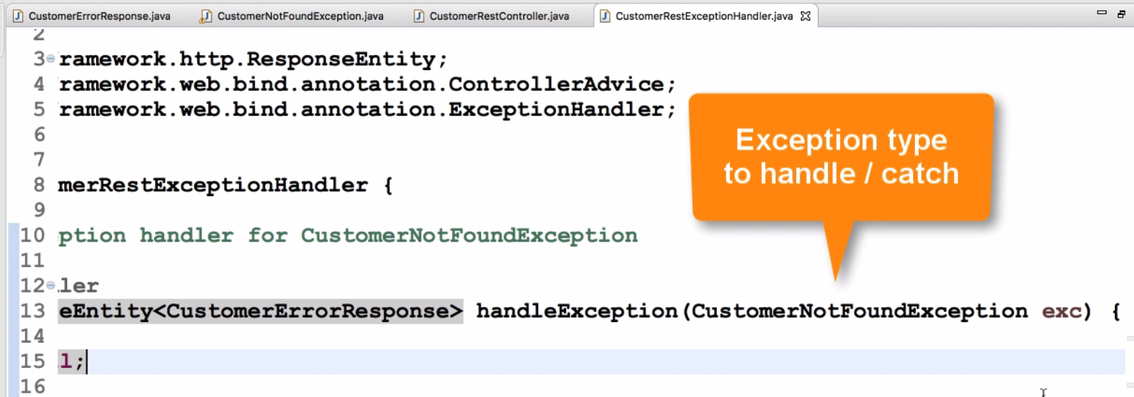

Slide 9
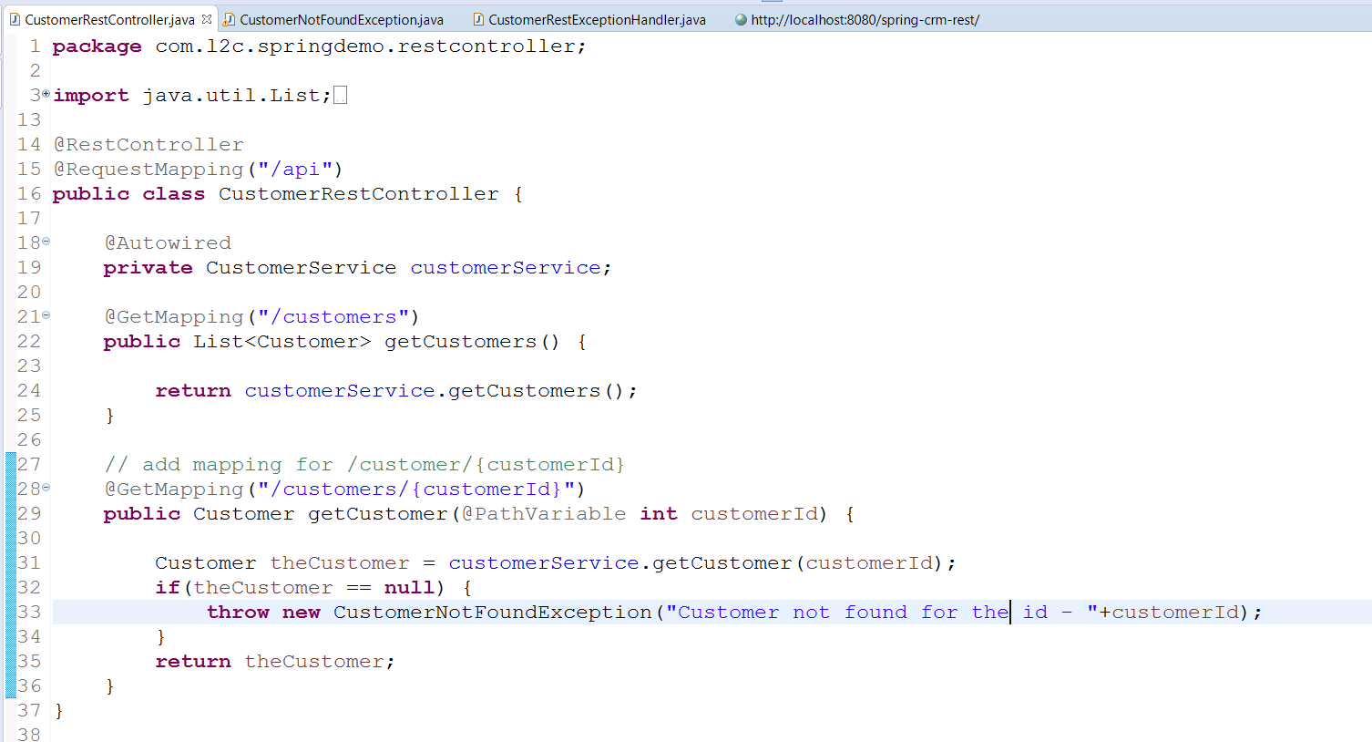
When ever user given in valid id, then the controller class throws CustomerNotFoundException along with message and id entered by the user.
We have a exception handler class called CustomerRestExceptionHandler, for handling user not found exception.

Slide 10
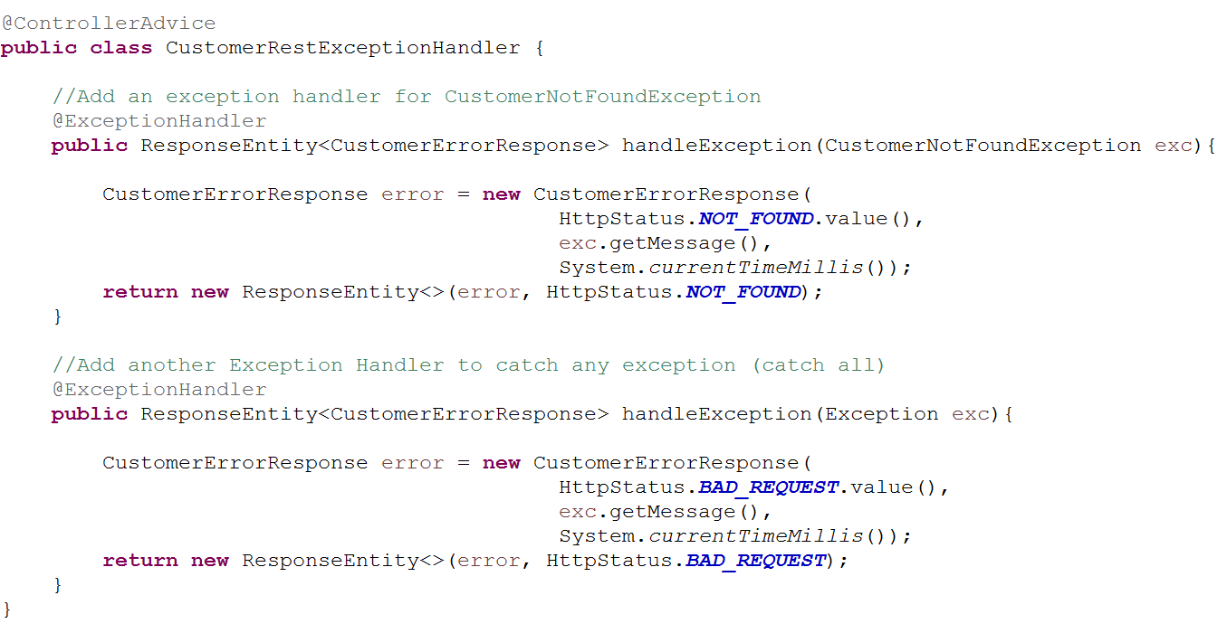
M
In the CustomerRestExceptionHandler class, we need to create two methods. One for handling CustomerNotFoundException.
Another for handling any exception the code is show in the previous slides.

Slide 11
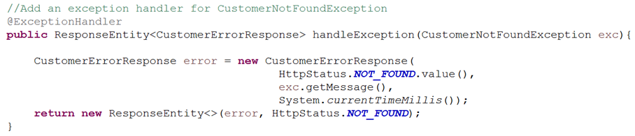

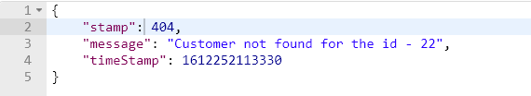
In This class, handleException(CNFE exc) method takes the id from the controller class, then creates the instance of CustomerErrorResponse bean, with the details sent by the controller class.
Then it will return the error message, (like “user not found for the id”) , time stamp, and status code as well.
If we try to pass invalid id(id not available in the db), we can see the our custom error in the postman.
Also in the other handle exception method(for BAD_REQUEST -400 error), handles any other exceptions.

Slide 12



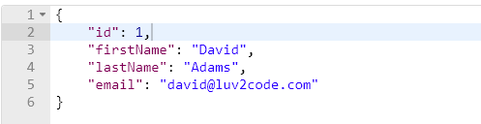
As shown like above, when we pass invalid id(in the form of String) we are able to display our customized error.
Finally if he passed valid id, this is how we can get a user based on id.

Slide 13
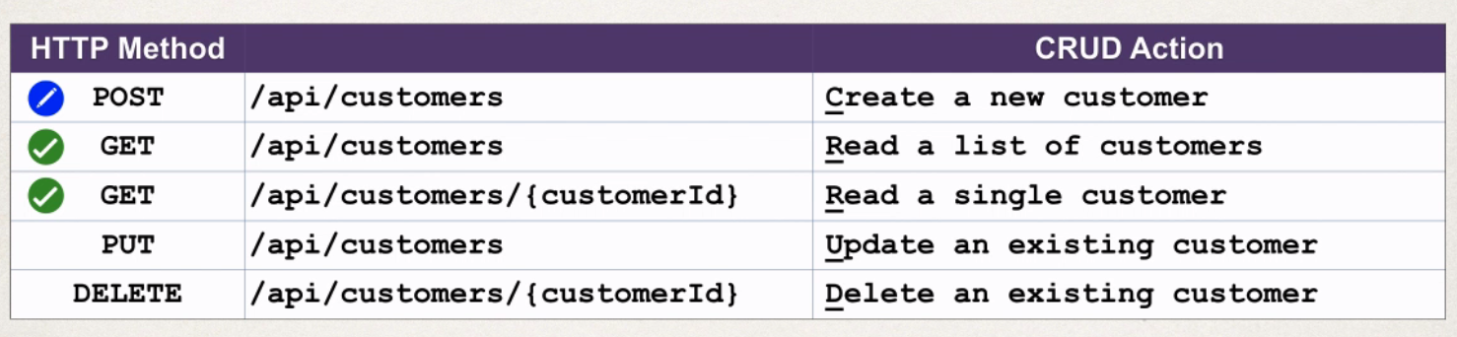
Spring Rest Add Customer
We already finished GET method to read list customer, and a single customer based on id.
Now we are making a post request for creating a new customer in the data base.

Slide 14
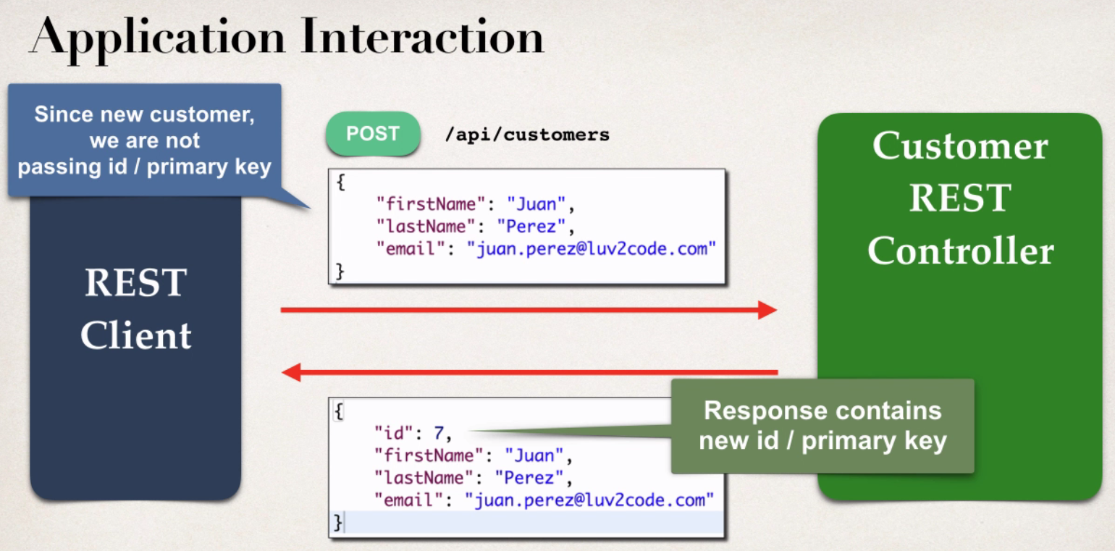
We will send a post request in the post man, we pass the first name, last name, and email as part of the request body.
We are not passing the id here, because we let hibernate to generate id.
This request will be send to CustomerRestController, this controller process it, and returns response which contains first name, last name, email and id as well.
This id is generated by hibernate in the background.

Slide 15
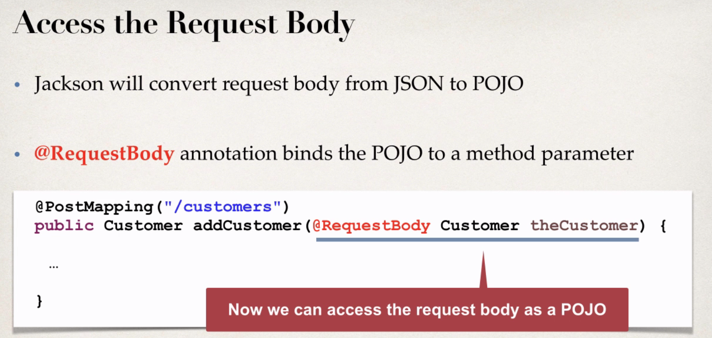
We already added a Jackson dependency , it will takes care of converting JSON to POJO.
The @RequestBody annotation binds the POJO to a method parameter. We no need to parse it to JSON manually.
In post man, we can pass the data(username, mail, status) as a request body. This is of type JSON, here the Jackson will convert the JSON to POJO , so it is easy to store in a database.

Slide 16
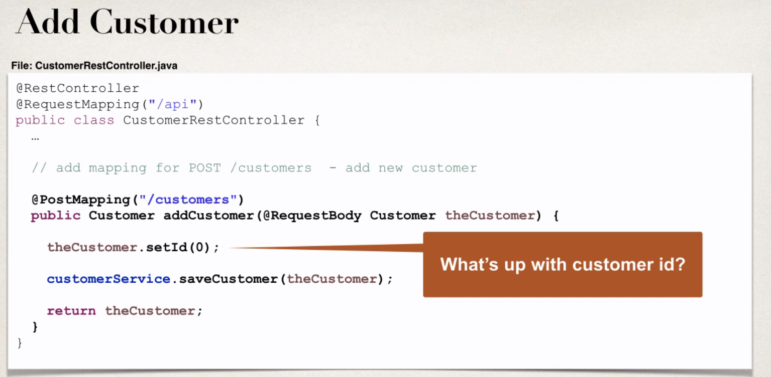
Here we are delegating the calls to our service, then returns the newly added customer.
But here we set the Id to 0(zero), because we are using hibernate to persist our data. Here given a method called saveOrUpdate() to store a new customer.
The way of this saveOrUpdate() method works, if the primary key of the column is empty or null, then it will create a new customer. Else it will update the existing customer.

Slide 17
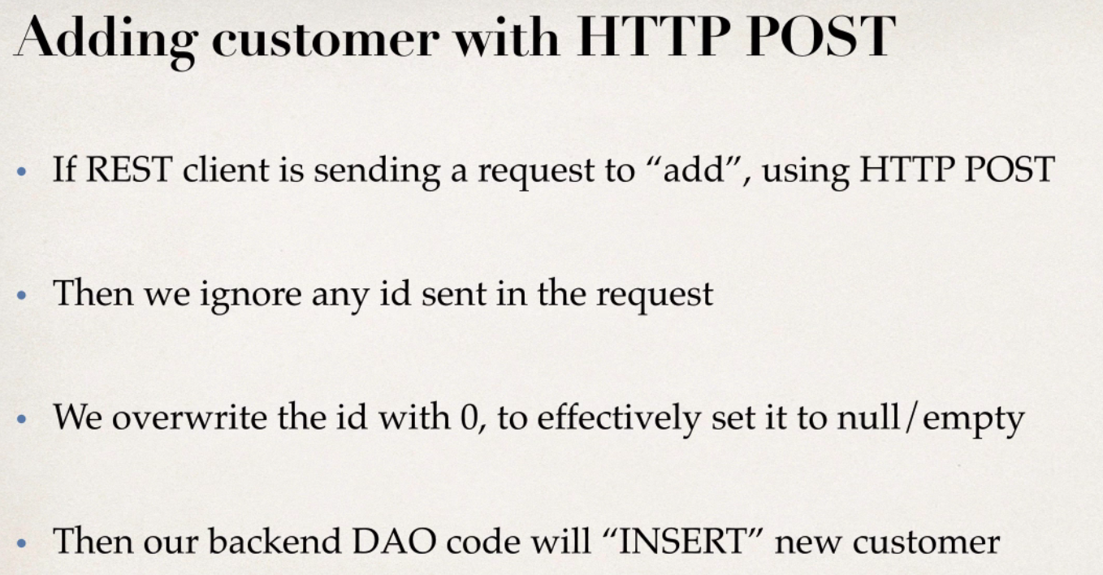
As we are creating a new customer, the primary key column should be empty or null.
We can make a column to empty, by setting it as 0.
That’s why we have given the id as 0 over there.

Slide 18
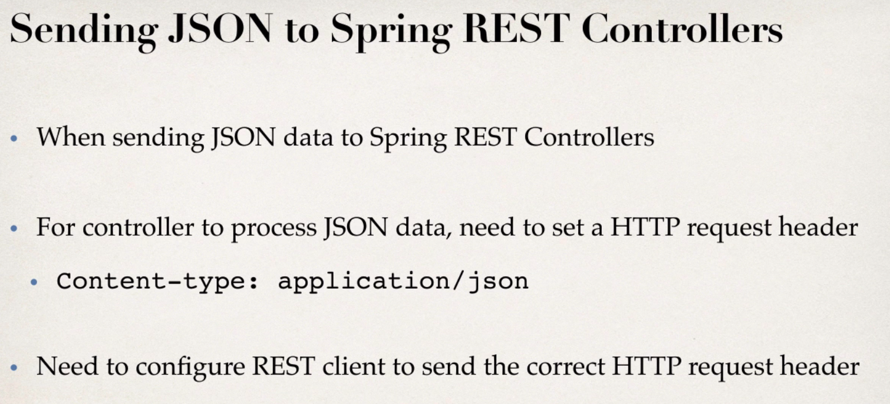
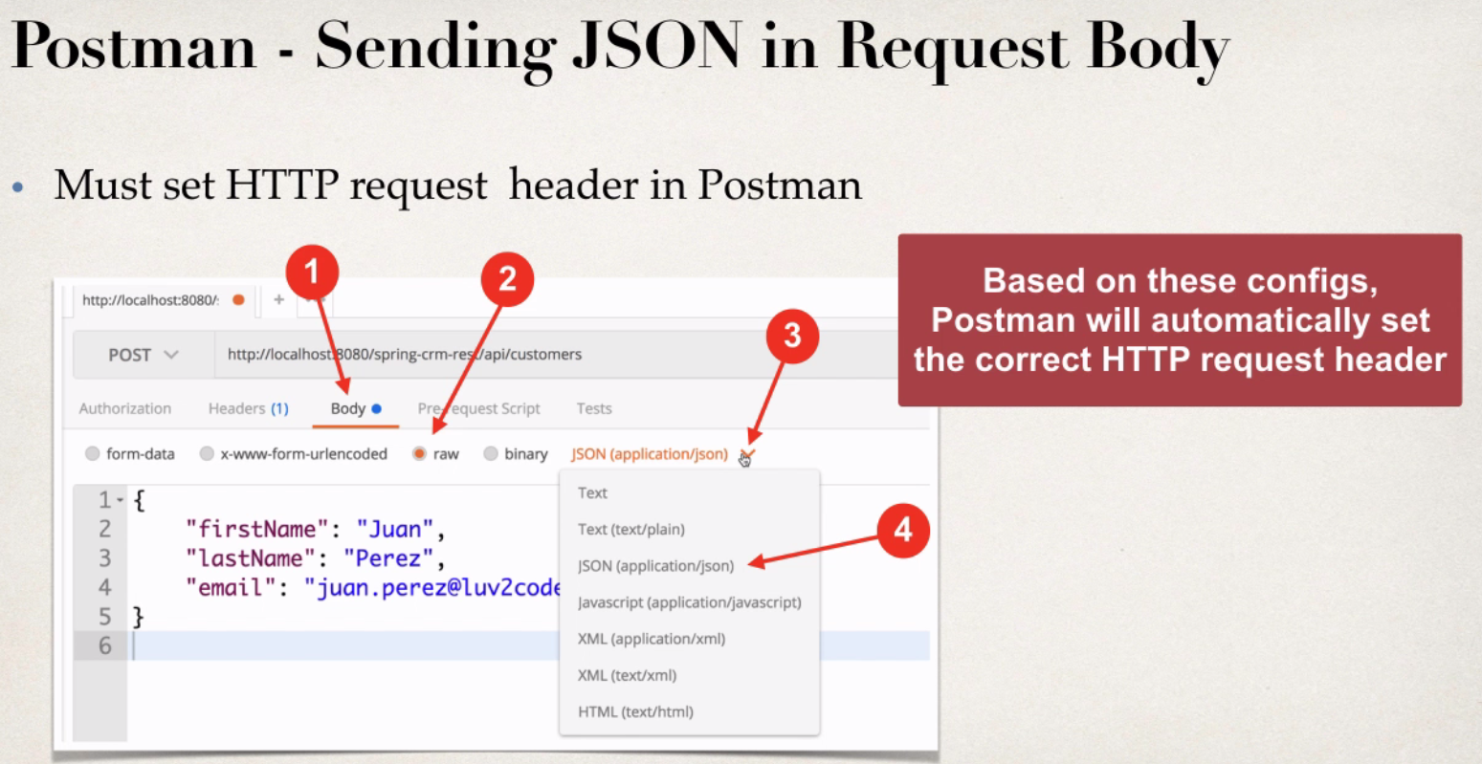

Slide 19
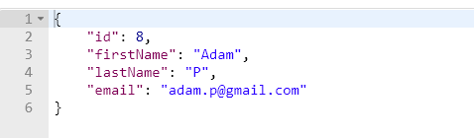
Once everything is done Run the application on server.
Open the post man, add a new customer as shown in the previous slide, then send a post request to the /customers
Make sure the new customer is created also having a new id generated by backend system.
Then open MYSQl work bench, double check whether the new customer is added or not.

